Slide 1
JUnit

Slide 2
JUnit
Resources:
http://www.vogella.com/tutorials/JUnit/article.html
http://junit.sourceforge.net/doc/testinfected/testing.htm
http://www.cse.chalmers.se/edu/year/2013/course/TDA566/juniteclipse.html

Slide 3
Junit – idea for self study
Work with JUnit in Eclipse
Look up this resource: http://www.vogella.com/tutorials/JUnit/article.html#juniteclipse
Read/scan paragraphs 1-4
Read/scan paragraph 5 and implement
‘5.3. Example Junit test’ (create code needed)
‘5.6. Junit test suites’ (create code needed)
Read/scan paragraphs 6-14 and implement
’11.1 Parameterized test’ 2. Example using a constructor

Slide 4
Junit
Annotations
Annotation | Description
@Test public void method() | The @Test annotation identifies a method as a test method.
@Test (expected = Exception.class) | Fails if the method does not throw the named exception.
@Test(timeout=100) | Fails if the method takes longer than 100 milliseconds.
@Before public void method() | This method is executed before each test. It is used to prepare the test environment (e.g., read input data, initialize the class).
@After public void method() | This method is executed after each test. It is used to cleanup the test environment (e.g., delete temporary data, restore defaults). It can also save memory by cleaning up expensive memory structures.
@BeforeClass public static void method() | This method is executed once, before the start of all tests. It is used to perform time intensive activities, for example, to connect to a database. Methods marked with this annotation need to be defined as static to work with JUnit.
@AfterClass public static void method() | This method is executed once, after all tests have been finished. It is used to perform clean-up activities, for example, to disconnect from a database. Methods annotated with this annotation need to be defined as static to work with JUnit.
@Ignore or @Ignore("Why disabled") | Ignores the test method. This is useful when the underlying code has been changed and the test case has not yet been adapted. Or if the execution time of this test is too long to be included. It is best practice to provide the optional description, why the test is disabled.
Source: www.vogella.com/tutorials/JUnit/article.html#juniteclipse

Slide 5
Junit
Methods to assert test results
Statement | Description
fail(message) | Let the method fail. Might be used to check that a certain part of the code is not reached or to have a failing test before the test code is implemented. The message parameter is optional.
assertTrue([message,] boolean condition) | Checks that the boolean condition is true.
assertFalse([message,] boolean condition) | Checks that the boolean condition is false.
assertEquals([message,] expected, actual) | Tests that two values are the same. Note: for arrays the reference is checked not the content of the arrays.
assertEquals([message,] expected, actual, tolerance) | Test that float or double values match. The tolerance is the number of decimals which must be the same.
assertNull([message,] object) | Checks that the object is null.
assertNotNull([message,] object) | Checks that the object is not null.
assertSame([message,] expected, actual) | Checks that both variables refer to the same object.
assertNotSame([message,] expected, actual) | Checks that both variables refer to different objects.
Source: www.vogella.com/tutorials/JUnit/article.html#juniteclipse

Slide 6
Junit
Write good JUnit test
Small specific test methods (do one thing)
Test method name indicates expected result
Keep Junit tests very simple Why?
Know equivalence classes
Use the AAA pattern
Arrange
Act
Assert

Slide 7
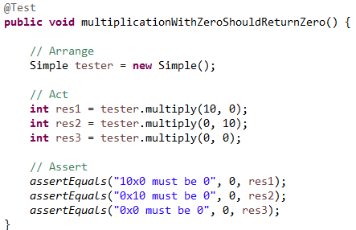
Junit
Example

Slide 8
Junit
Demo
Test calculations
Test exception handling
Run test suite
Test insert in database

Slide 9
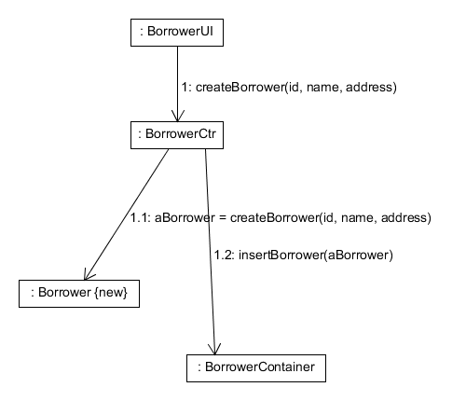


JUnit - demo
Sequence diagram – Create borrower
Notes:
SW project

Slide 10
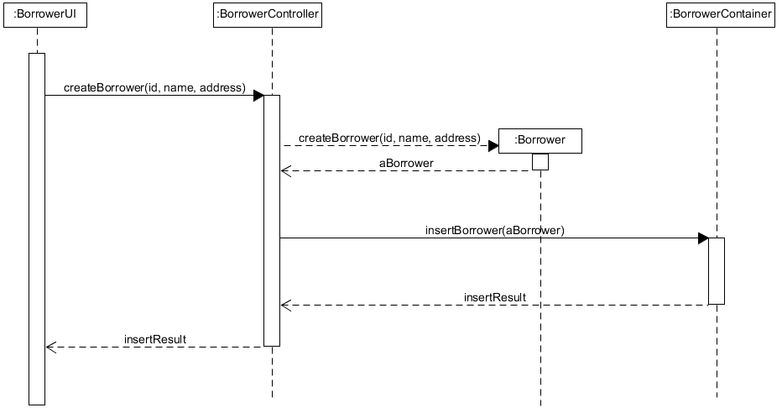
JUnit - demo
Sequence diagram – Create borrower
Notes:
SW project

Slide 11
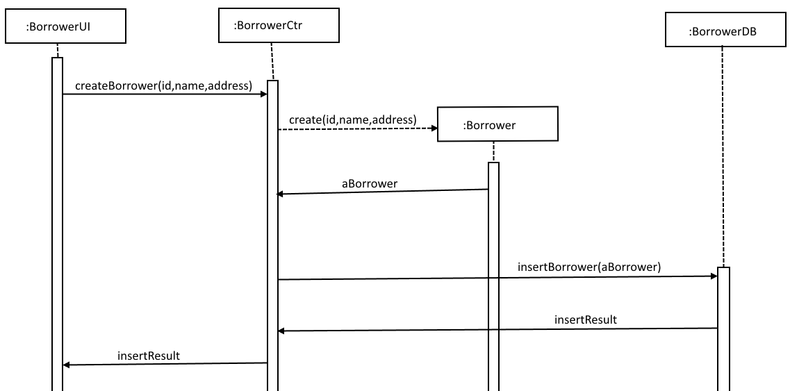
JUnit
Demo incl.
Sequence diagram – Create borrower

Slide 12
JUnit
Demo
Basic http://www.vogella.com/tutorials/JUnit/article.html
Run test suite
Test exception handling
Library - Test insert and delete Borrower

Slide 13
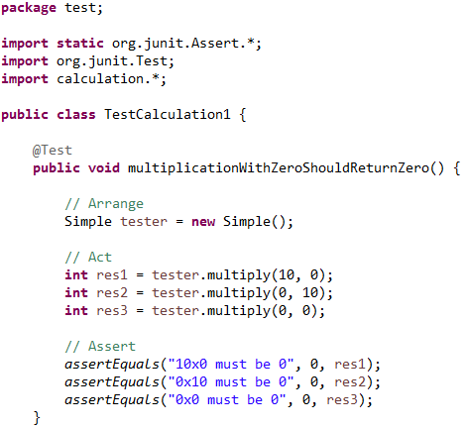
JUnit
Demo - documentation
Basic

Slide 14
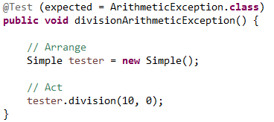
JUnit
Demo - documentation
Test exception handling

Slide 15
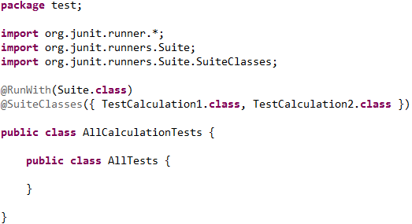
JUnit
Demo - documentation
Run test suite

Slide 16
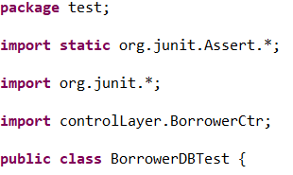
JUnit
Demo - documentation
Library - Test insert and delete Borrower

Slide 17
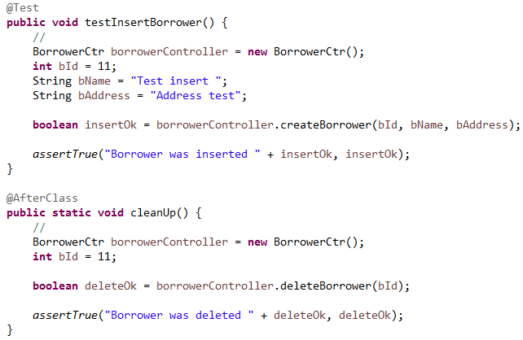
JUnit
Demo - documentation
Library - Test insert and delete Borrower

